Slide 1
Dr. Montaser m. dabah
Pediatric Emergency

Slide 2
Cardiopulmonary arrest:
-Definition :
-Causes :
- Diagnosis :

Slide 3
Cardiopulmonary resuscitation
1- basic life support ( A + B+ C) :
aims to restore spontaneous breathing and circulation .
A- airway control
1- open the airway
2-clear the airway
3-maintain patent airway

Slide 4
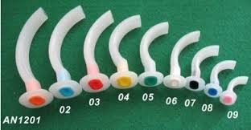
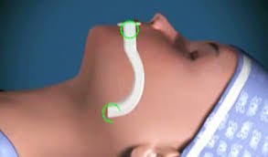
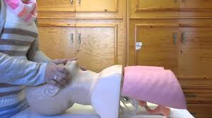

Slide 5
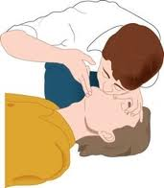
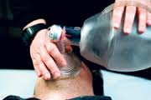
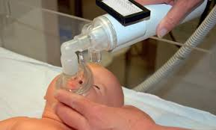
B- breathing support
1- mouth- to mouth breathing
2-bag and mask ventilation
3- bag and tube ventilation

Slide 6
C- circulation support:
Site of compression: midsternum point
Technique of compression:
- in newborn( hand encircling technique)
-in infants( tow fingers technique)
-in young children(one hand technique)
-in old children( tow hands technique)
Depth of compression: 2 cm
Frequency of compression:100 \ min

Slide 7
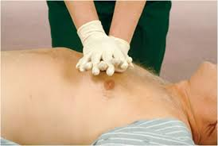
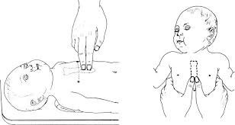

Slide 8
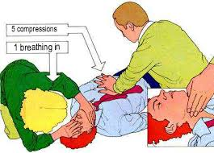
All together:
keep airway patient, continue ventilation and cardiac compression at a ratio of 1 : 5

Slide 9
2- advanced life support
(D+ E+ F)
Indicated when basic life support is not successful(continue arrest).
1- maintain A+ B+ C
2- insert I.V line and give fluids(Ringer’s lactate)
3- then D+ E+ F

Slide 10
1- Drugs:
- Give sodium bicarbonate: 2 ml/kg of 5% solution
- give adrenaline : 0.1 ml/kg of diluted solution (1 ml + 9 ml saline)

Slide 11
2-EEG monitoring:
- It is important to detect various cardiac arrhythmias.
- with asystole : repeat adrenaline (10 times) the first dose

Slide 12
3- fibrillation control:
- Indicated with ventricular fibrillation
- Defibrillate up to 3 times: 2 joules/kg then 4 joules/ kg

Slide 13
Circulatory failure(shock)
Shock is a serious life threatening condition characterized by tissue hypo perfusion

Slide 14
Clinical grading of shock
Grade I (early shock= peripheral hypo perfusion)
- tachycardia & poor peripheral perfusion
Grade II(established shock=arterial hypoperfusion)
-tachycardia, poor peripheral perfusion & hypotension

Slide 15
Clinical grading of shock
Grade III (advanced shock=vital organ hypo perfusion)
- multiple organ system failure(MOSF )
Grade IV (irreversible shock=irreversible cellular damage )
- refractory metabolic acidosis

Slide 16
Causes of shock
S : Septic shock
- primary septicemia( fulminant sepsis )
- Secondary septicemia( due to focal infection)
H : Hypovolemic shock
-sever dehydration( diarrhea, vomiting, DKA)
- sever hemorrhage
O : Obstructive shock
- tension pneumothorax or hemothorax
- cardiac tamponade ( pericardial effusion )

Slide 17
Causes of shock
C : Cardiogenic shock
- Sever acute heart failure
- Late septic shock ( due to toxic myocarditis)
K : Kinetic or distributive shock
- anaphylactic shock
- Neurogenic shock

Slide 18
Management of shock
1- clinical monitoring :
- Heart and respiratory rates
- Peripheral perfusion (capillary refill time)
- Arterial blood pressure
-urine output ( 2-3 ml/kg/hr )
-level of consciousness
- arterial O2 saturation (more than 95%)

Slide 19
Management of shock
2- laboratory monitoring:
- Arterial blood gases
- Serum electrolyte
- blood glucose
- Hb%, coagulation profile
- Sepsis screen( CBC, ESR, CRP, blood culture)
- Renal function tests

Slide 20
Management of shock
3- radiological & imaging monitoring:
- Chest x-ray
- ECHO
4- invasive hemodynamic monitoring:
- CVP
-pulmonary artery pressure

Slide 21
Cardiovascular support :
1- O2 therapy( to prevent myocardial hypoxia)
2- preload augmentation( ringer’s lactate 20 ml/kg over 15 min) the dose can be repeated twice.
3-contractility augmentation (I.V infusion of dopamine, dobutamine or both)
4- afterload reduction( I.V infusion of nitroprusside )
5- treatment of cardiac arrhythmias

Slide 22
Multisystem support in MOSF
1- respiratory
2- renal
3- metabolic
4- GIT
5- hematological support

Slide 23
Specific treatment :
1- septic ( antibiotics)
2- hypovolemic ( blood transfusion)
3- anaphylactic (steroid, antihistamine)

Slide 24
Acid- base disorders
Acid- base balance is the balance of the free hydrogen ion concentration in the body , which is kept constant by buffering systems, pulmonary mechanism and renal mechanism.
In acid- base disorders, the buffering systems are unable to maintain a normal PH and their action should be supplemented by initial compensation and ultimate correction

Slide 25
1- metabolic acidosis :
Causes :
1- excess acids
-cardiopulmonary arrest – sever hypoxemia
-advanced shock -acute renal failure
- DKA - aspirin toxicity
2- base loss ( diarrhea –renal tubular acidosis)

Slide 26
Diagnosis of metabolic acidosis
1-acidotic breathing ( deep rapid respiration )
2- disturbed consciousness
3- cardiac arrhythmias
4- blood gas analysis ;
low PH ( 7.3) low HCO3 (16 mEq/l)
low PCO2

Slide 27
Treatment of metabolic acidosis:
1- correction of acidosis :
Na HCO3 1 ml / kg of 5% solution over 10 min
2- specific treatment of the cause

Slide 28
Electrolyte disorders
1- hyponatremia :
- serum Na less than 130 mEq/ l
- Hyponatremic dehydration - diuretics
- Volume overload - iatrogenic hyponatremia
- Fresh water- near drowning
- Shock , coma and convulsion
- I.V infusion of normal saline, Nacl 3% slow I.V infusion

Slide 29
2- hypernatremia
1- serum Na more than 150 mEq / l
2- hypernatremic dehydration – D.M
- D. insipidus - salt water- near drowning
- iatrogenic hypernatremia
3- increased ICP, coma and convulsion
4- slow correction, anticonvulsants, peritoneal dialysis

Slide 30
3- hypokalemia
1- serum K less than 3 mEq / l
2- alkalosis - DKA - diarrhea
- acute hepatic failure - diuretics, steroids
3- hypotonia, abdominal distension, arrhythmias
4- oral potassium (2-4 mEq/ k ) , I.V potassium in sever cases 1.7 ml / 100 ml of glucose- saline mixure

